Slide 1
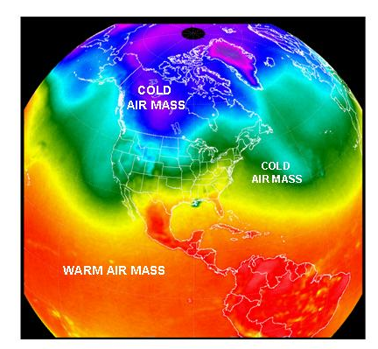
Air Mass
By –
Kaustuv Mukherjee
Dept. of Geography,
Chandidas Mahavidyalaya

Slide 2
In meteorology, an air mass is a volume of air defined by its temperature and water vapor content. Air masses cover many hundreds or thousands of square miles, and adapt to the characteristics of the surface below them. They are classified according to latitude and their continental or maritime source regions.

Slide 3
Air Masses
A body of air with more-or-less uniform physical properties over horizontal distances of hundreds of kilometres
Temperature
Moisture content
lapse rate
Properties and degree of uniformity depend on:
Source of the air
History – air mass modification
Age of air mass
Input of heat and moisture to atmosphere is non-uniform. Creation of a uniform air mass achieved via:
Mixing
Radiative processes
Time (3 – 7 days)
Notes:
Uniform air masses tend to form in particular areas – extensive regions of uniform surface properties.
Most atmospheric processes result from regulation of imbalances in distribution of heat, moisture, and pressure – on a small scale some degree of homogeneity can be achieved through mixing & radiative processes – move towards equilibrium with surface…requires time.
High pressure cells – source regions. Air masses move towards low pressure cells.

Slide 4
Source Regions
If a large body of air sits over an area of land or water for a long period of time, it will take on the characteristics of the land or water beneath it – this land or water area where air masses originate is called as Source Regions.
Air masses tend to form in areas with little wind.
Remember, they sit over an area for a long period of time without moving.

Slide 5
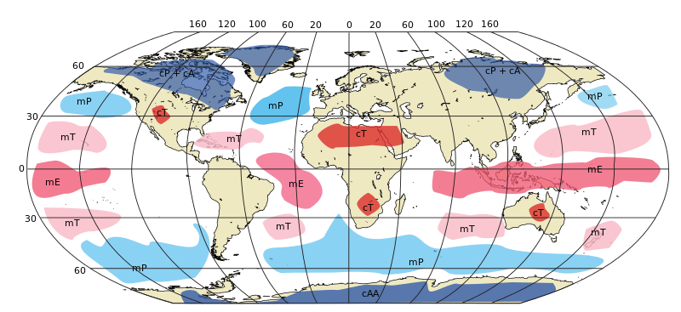
Source Regions
Source Regions: areas of extensive uniform surface conditions situated below quasi-stationary high pressure systems.

Slide 6
Air Mass Modification Processes
Thermodynamic
Surface heating/cooling
Change of temperature of surface, or advection over different surface
Addition of moisture
Surface evaporation
Evaporation of precipitation falling from higher level
Loss of moisture
Condensation, precipitation
Radiative heating/cooling
slow compared to surface heat exchange (up to 2 weeks)
Dynamic
Turbulent mixing
Increases uniformity of air mass. Very efficient close to surface.
Large-scale lifting/descent
Causes adiabatic changes of temperature
May result in formation or evaporation of clouds
Notes:
Processes are not all strictly distinct – turbulent mixing required to effect surface exchanges.
More than one process may operate at a time.

Slide 7
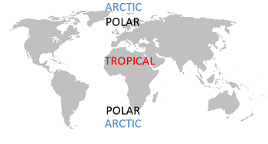
Location…
Air masses over the equator will have high temperatures.
Air masses over polar regions will have low temperatures.
Air masses over water (maritime) will have high humidity (moisture content).
Air masses over land (continental) will have low humidity (moisture content).

Slide 8
Air Mass Classification
Air masses are classified according to how they compare to the properties of the underlying surface and of adjacent air masses.
4 (sometimes 5) basic classifications – combine source region and surface type:
Maritime/marine (m)
high moisture content
Continental (c)
typically low moisture
Tropical (T)
warm
Polar (P)
cold
Also:
Arctic (A)
very cold
Frequently indistinguishable from polar air masses in lower levels
Originates over polar icecaps rather than high latitude land masses.
Some classification schemes include indication of whether air is warmer (w) or cooler (k) than underlying surface after air mass modification has taken place; e.g. cPk, mPw.

Slide 9
Continental Polar (cP)
Origin: continental anticyclones over Siberia and northern Canada during winter; Arctic basin (cA) when high pressure dominant. No sources of cP in southern hemisphere. Antarctica is a source of cA all year round.
Snow covered surface ⇒ cooling of surface layers, equilibrium vapour pressure is low ⇒ low moisture content (0.1 to 0.5 g/kg).
Cooling at surface ⇒ stable stratification, limited mixing; allows further cooling by radiation resulting in very low temperatures.
Subsidence of air aloft (and associated adiabatic warming) combined with radiative cooling at low levels ⇒ pronounced inversion from surface to about 850 mb (~1 km).
Low humidity results in generally low cloud amounts.
Solar heating of land surface in summer removes source of cold air.

Slide 10
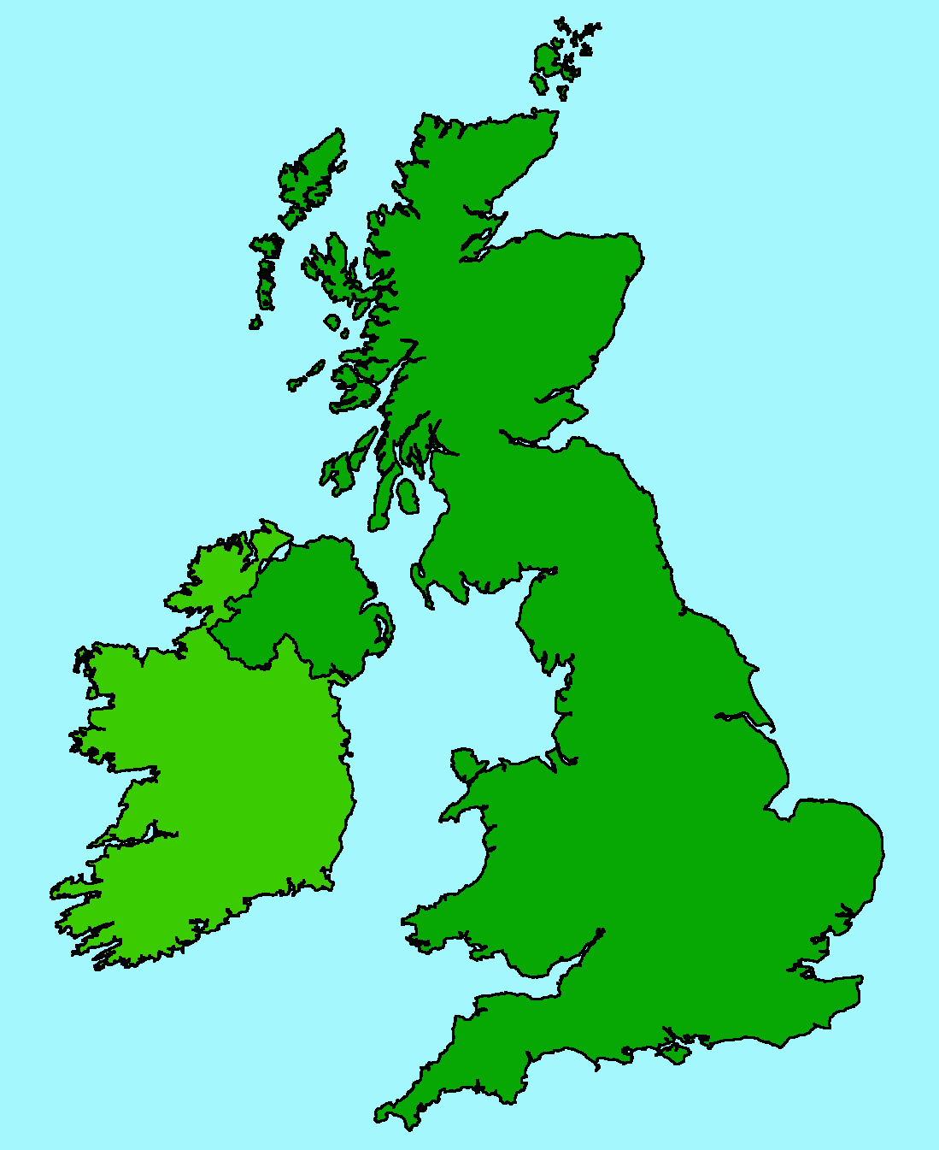
H
Continental Polar (cP)
Source: Siberia, very cold in winter, hot and dry in summer.
Summer: Warm & dry, cloud free, except perhaps at east coast where cool & showery.
Winter: Snow near east coast; occasional snow showers in west. Very cold & strong easterly winds
Track: overland, short track over
North Sea

Slide 11
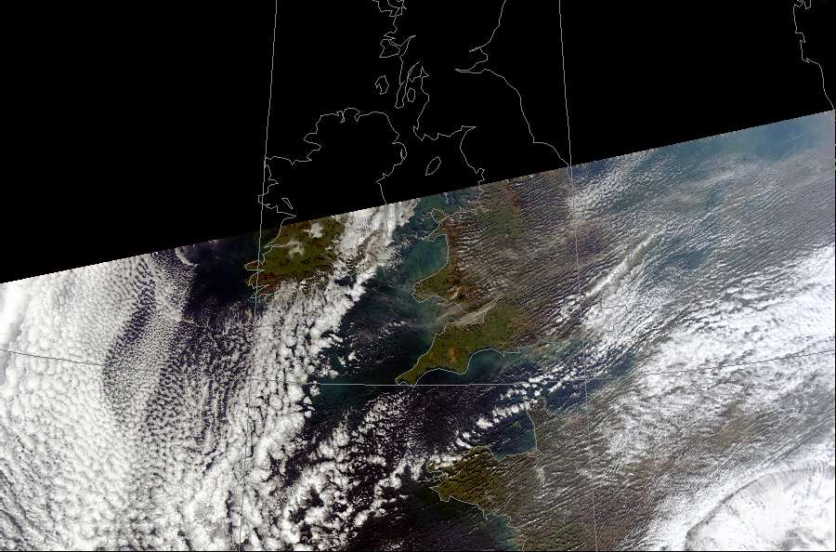

Slide 12
Maritime Polar (mP)
Origin: In northern hemisphere mP results primarily from modification of cP by flow over oceans: Siberia flowing over north Pacific, northern Canada & Greenland flowing over north Atlantic.
In summer the Arctic icecap – significant areas of melt water, and open leads in ice, provide effective water surface.
In southern hemisphere: oceans surrounding Antarctica.
In winter modified cA provides colder mP than modified cP.
Cool and moist, extensive cloud cover.
During initial flow over water, cP is warmed and moistened. High surface heat and moisture fluxes ⇒ instability and strong convection; flow is very turbulent, increasing amounts of cumulus form, often in streets aligned with wind.
Downwind, large cumulus organised in first closed, then open cells. Air mass now cool, moist mP, extensive cloud cover.

Slide 13
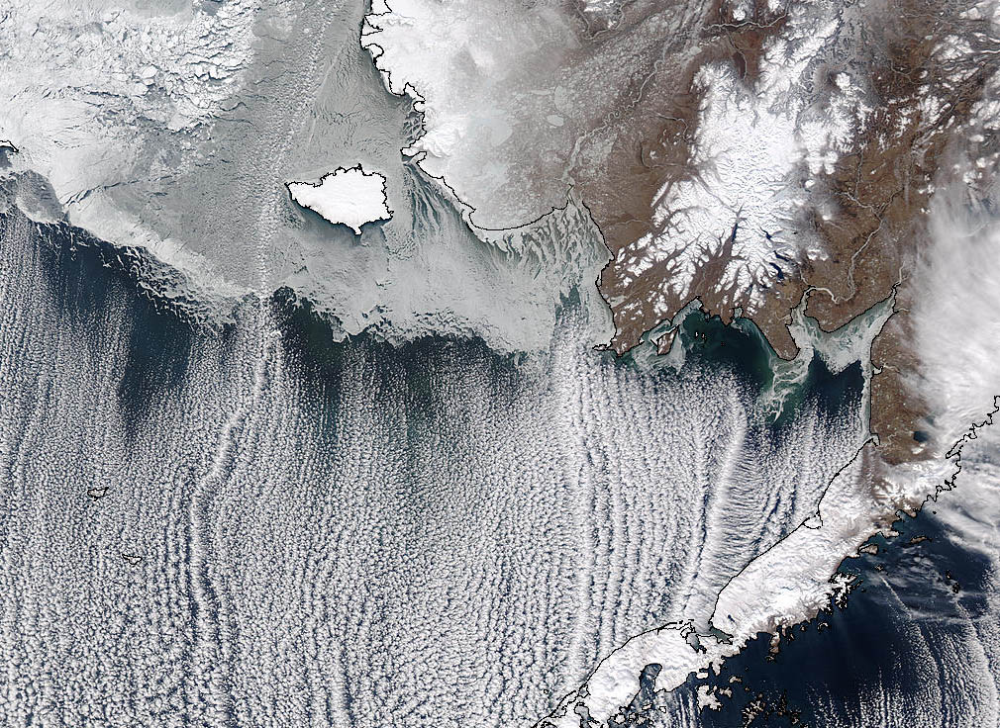
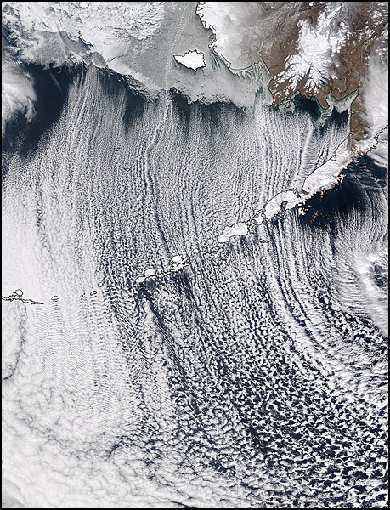

Slide 14
Maritime Polar (mP)
Source: North Canada & Greenland. Very cold.
Summer: Heavy showers, thunderstorms over high ground.
Winter: Heavy showers in north-west; clear skies in east at night giving frost. Dry in lee of mountains.
L
Track: cool, moist,
unstable

Slide 15
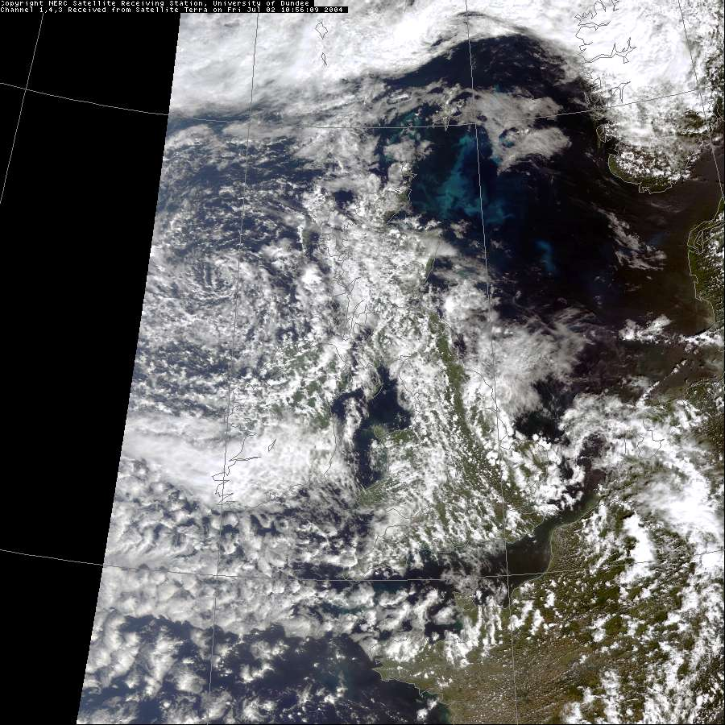

Slide 16
Returning Polar Maritime
Source: North Canada. Very cold and dry
Summer: Very warm, stratus clouds in south­west, squally showers & storms inland.
Winter: stratus cloud, showers over high ground, particularly in west.
L
Track: warmer & wetter than mP

Slide 17
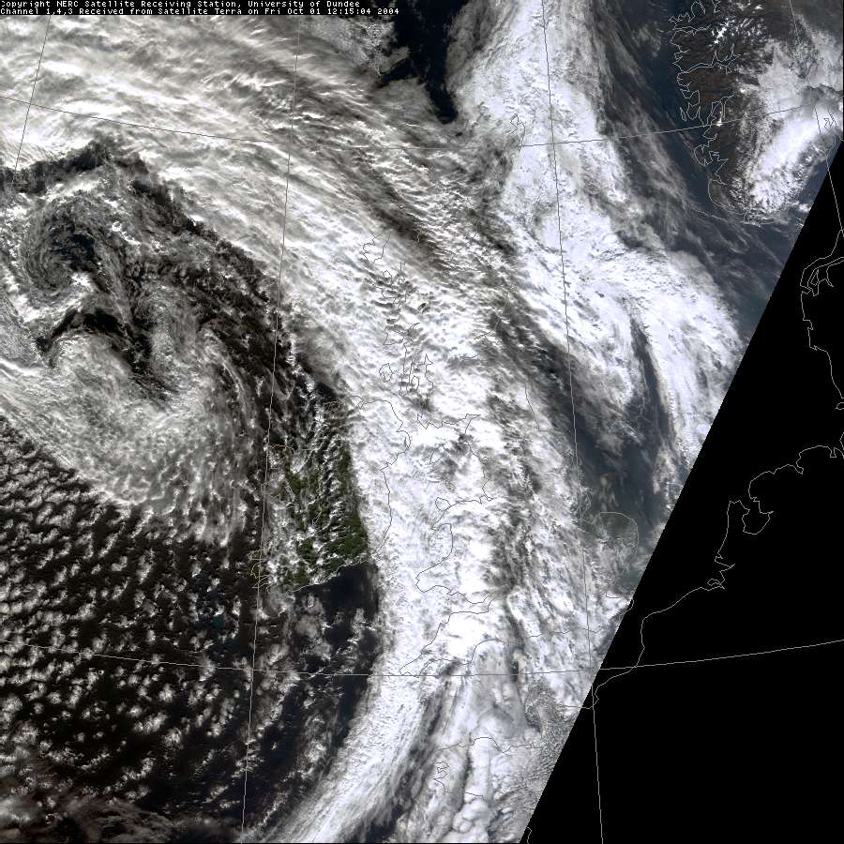

Slide 18
Arctic Maritime (mA)
Source: Arctic seas / ice­cap. Very cold.
Summer: Cold, frequent heavy showers.
Winter: Very cold; strong winds from north and north­west. Heavy snow showers, particularly in north and coastal areas. Cold & bright in lake district and South Wales in lee of mountains to north.
Track: short; warm & moist at surface, cold aloft; unstable
L

Slide 19
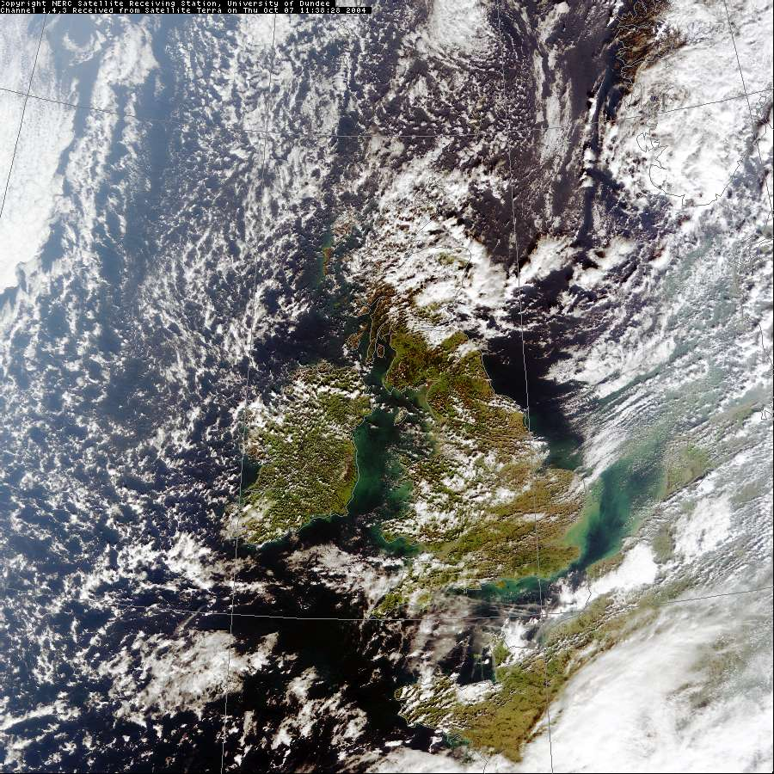

Slide 20
Maritime Tropical (mT)
Origin: Oceanic subtropical high pressure cells – mid Atlantic (Azores High), much of pacific. 50% of southern hemisphere is a source of mT.
High temperatures, and high humidity in lower layers. Stable or near neutral stratification.
Modification of warm air is usually slow.
Cooling from surface as air moves to higher latitudes results in formation of advection fog. If wind speed is high, mechanical mixing produces a deeper boundary layer (few hundred metres) and low stratiform cloud forms – stratus or stratocumulus.
Forced ascent at land can result in thick cloud and heavy rain.
Advection fog, Golden Gate Bridge
Notes:
Advection fog common in southwest approaches to English channel

Slide 21
Maritime Tropical (mT)
Source: warm tropical oceans
Summer: South­west winds; warm & sunny inland. Low stratus clouds round west coast.
Winter: Stratus clouds/hill fog/drizzle clearing to the north­east. Warm, muggy, with prolonged rainfall in westerly mountains.
L
Track: moist at surface
H

Slide 22
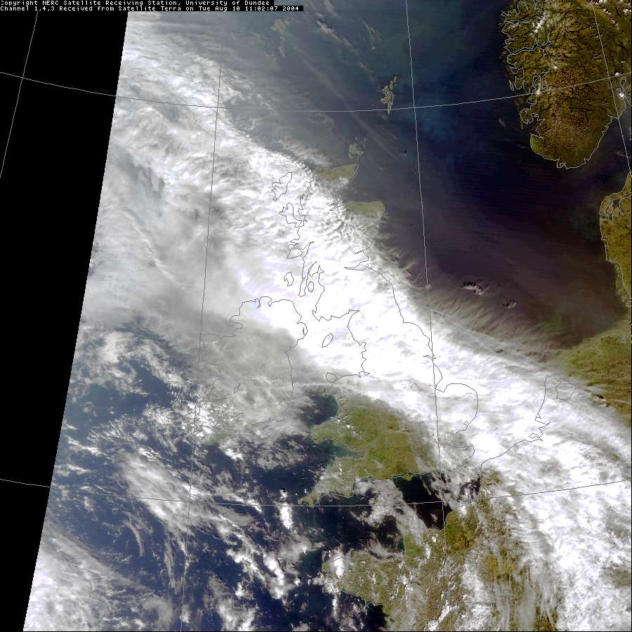

Slide 23
Continental Tropical (cT)
Origin: Continental parts of subtropical high pressure cells (e.g. north Africa) or regions of generally light, variable winds & subsidence in upper troposphere over major landmasses during summer (e.g. central Asia).
Strong solar heating of land mass results in unstable stratification and strong convection. Low humidity coupled with subsidence means limits cloud development and preciptitation.
In the northern hemisphere winter, north Africa is the only source of cT.
Modification during transit over water (e.g. from N. Africa moving over Mediterranean into Europe): picks up lots of water vapour, lowering the density of humidified air and triggering strong convection. Large cumulus and thunderstorms form.

Slide 24
Continental Tropical (cT)
Source: North Africa – hot and dry.
Summer only: Heat­wave weather, hazy with occasional thunderstorm.
H
Track: overland with short sea track
L

Slide 25
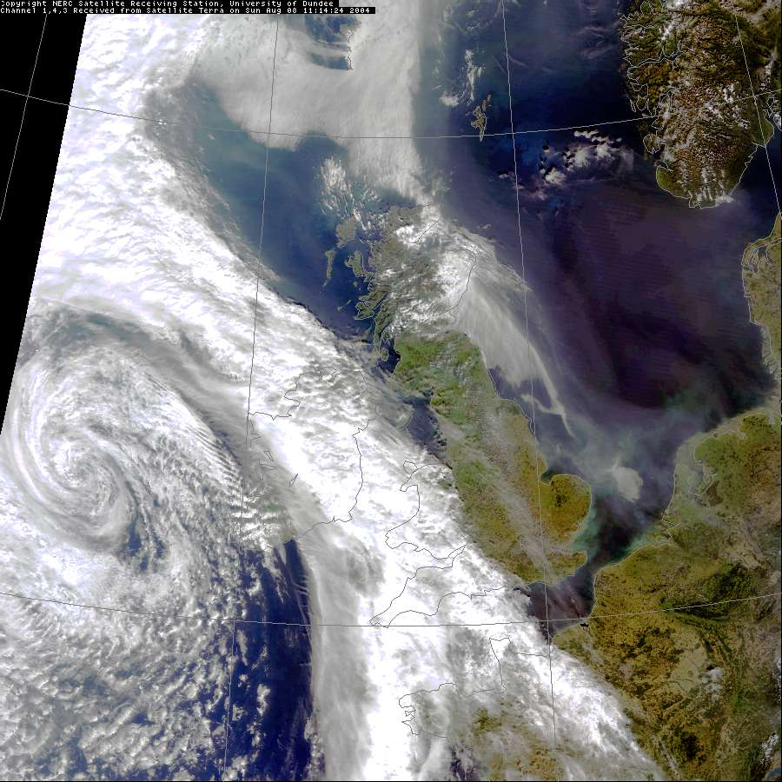

Slide 26
Summary
“Air masses” are large regions of air with distinct properties
Originate in high-pressure regions, and move towards low pressure
Modified by changes in surface properties, and radiative warming/cooling

Slide 27
Thank You

